Slide 1
Buford Highway
Arterial Rapid Transit (ART)
Project Briefing
June 23, 2022

Slide 2
Tips for Today’s Meeting
Your microphone had been muted to avoid any background noise.
Submit project specific questions in the chat
Contact customer service at custserv@itsmarta.com for questions on existing service.
We will address as many questions/comments as time will allow.
If you miss any details during the presentation, it will be posted to the project web site.
PROJECT CONTACT:
Tracie Roberson Transit System Project Planner
bufordhwyart@itsmarta.com
Notes:
First we want to provide context on What is Arterial Rapid Transit?
Arterial Rapid Transit is a new service type that MARTA in implementing in the Atlanta Region. This type of service is used to improve bus operations in a corridor by providing frequent service in highly travelled corridors, it will operate in the same lanes as other traffic, it will have busses running every 10 minutes or faster, it will be coordinated with the traffic signals to reduce schedule delays, there might be options for busses to bypass traffic using a queue jump lane.

Slide 3
Agenda
Welcome and Introductions
What is Arterial Rapid Transit (ART)
Project Background
Buford Highway ART Overview
Project Timeline
Discussion
Notes:
Welcome and thank you for joining us to learn more about MARTA’s plans for Arterial Rapid Transit on Buford Highway.
I would like to introduce the team that is here today.
<<Ask representatives from MARTA to say hello>>
<<Ask the Consulting team to say hello>>
<<Ask if there are any elected officials that would like to introduce themselves>>
This evening we are going to provide a description of ART, background on the project. An overview of project details and the timeline.

Slide 4
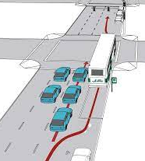
What is Arterial Rapid Transit (ART)?
Fast, Frequent on existing high-density, mixed-use arterial corridors
Traffic signal priority
Operated in mixed-traffic with other vehicles
Queue jump lanes
Image Source*
Short wait times
Enhanced amenities
*Bus Priority Program Toolbox-Government of the District of Colombia
Notes:
First we want to provide context on What is Arterial Rapid Transit?
Arterial Rapid Transit is a new service type that MARTA in implementing in the Atlanta Region. This type of service is used to improve bus operations in a corridor by providing frequent service in highly travelled corridors, it will operate in the same lanes as other traffic, it will have busses running every 10 minutes or faster, it will be coordinated with the traffic signals to reduce schedule delays, there might be options for busses to bypass traffic using a queue jump lane.

Slide 5
ART Amenities
Optional
Sheltered waiting
areas
Seating
Call boxes
Real-time information
Lighting
Security cameras
Breeze vending
Trash receptacles
Bicycle storage
Notes:
The ART Stations will have amenities beyond a typical bus stop and include the items listed:
Sheltered waiting areas
Real-time information – which lets you know the arrival time of your next bus
Breeze vending – to purchase fares – this will be at the locations with the highest number of riders
Seating
Lighting
And trash receptacles
In addition to these amenities there are optional amenities under consideration:
Call boxes
Security cameras
Bike storage

Slide 6
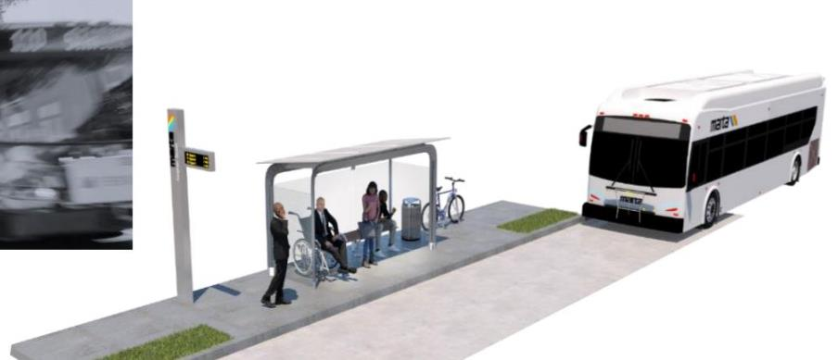
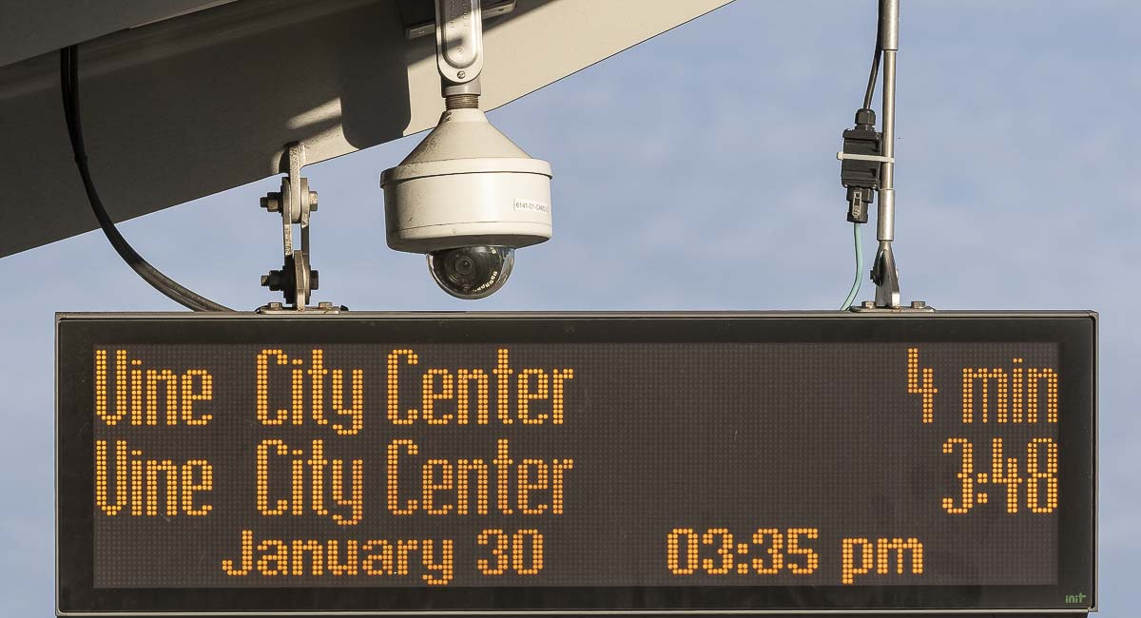
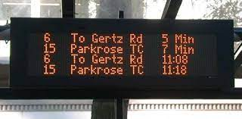
Station Amenities
Enhanced Lighting
Bicycle Racks
Security Cameras
Real Time Digital Signage
Seating
Placed near pedestrian signals and crossings
Notes:
Shown on this slide is a rendering of what a station could look like and highlights some of the amenities that may be included.
Safety is a priority when planning for any station and these stations will be connected to sidewalks and located near pedestrian crossings for safe access to the ART.

Slide 7
Examples of ART Stations
Minneapolis, MN
Kansas City, MO
Notes:
The previous slide showed a rendering of what the station might look like, but we also wanted to share some examples of ART in real life.
These examples show the variability you can have with shelter design, different options for displaying information and different styles for station markers.
As MARTA moves from this phase into final design, more specifics on the station style will be developed.

Slide 8
Benefits of ART
Faster boarding
Reduces travel time
Improves safety
Increases transit reliability
Creates connections
Reduces Greenhouse Gas (GHG) and local air pollutant emissions
Notes:
The reason that MARTA is implementing ART service in this corridor is because of the benefits it can provide to the system and to the riders.
ART can have faster boarding because of changes in how fare is collected and because of easier station boarding. Faster boarding means that the bus spends less time at each stop and is able to better maintain the schedule.
Overall travel time can be reduced because of station consolidation and better coordination with the traffic signals that improve bus flow through the corridor.
Stations will be well let and well connected to the pedestrian network which improves the overall safety.
When the buses have less time idling at stations, it reduces overall emissions which is better for air quality. Additionally, MARTA is continuously focused on reducing environmental impacts by using natural gas vehicles and electric vehicles.

Slide 9
DeKalb County Arterial Rapid Transit
DeKalb Transit Master Plan (2019)
Buford Highway – ART funded
Candler Road – ART funded
Implementation in 2024
MARTA delivering through 15th Amendment
Extends full penny sales tax through 2057
Provides secure funding stream for ART projects
Current Activity
Conceptual station design for both projects underway
Outreach
Coordination with GDOT
Notes:
Now that we have discussed what ART is, we would like to provide some background on the project.
Arterial Rapid Transit has been identified in several previous planning efforts as a beneficial service type in transit corridors that serve high ridership. Most recently, this project and another project in DeKalb County, Candler Road, were identified in the DeKalb County Transit Master Plan that was completed in 2019.
The good news about these projects is that local funding is in place to be able to construct these projects by 2024. That funding became available through legislation referred to as the 15th Amendment. The existing MARTA one penny sales tax would have changed to a half penny sales tax in 2047. The 15th Amendment keeps it to one penny through 2057. This creates more revenue than previously planned and allows MARTA better options for bonding the funds needed to deliver these projects.
The current work being done by MARTA is to develop conceptual station designs for Buford Highway, meet with key stakeholders and the public as we are now to discuss the project and coordinate with the Georgia Department of Transportation. Because Buford Highway is a state route, MARTA and GDOT will work together on any changes to the roadway. Especially in relation to programming the traffic signals to facilitate bus operations.

Slide 10
Project Overview
ART from the Lindbergh Center MARTA Rail Station to the Doraville MARTA Rail Station
Runs through:
Atlanta
Brookhaven
Chamblee
Doraville
Notes:
This project is similar to MARTA Route 39 that operates today. This project would connect to the Lindbergh MARTA rail station on the south and the Doraville MARTA rail station to the north. The route is about 10 miles long and runs through four cities and two counties.

Slide 11
Corridor Characteristics
Source: ACS (2015-2019); CTG/ETC Institute Route 39 On-Board Survey (2019)
Trips to Work
Transit Rider Age
Route 39 Riders Transferring to Rail
30% commuting to work via transit
51%
of riders aged 35-64 years
81%
of all Rt 39 transfers
to rail
Household Income
No Vehicle Access
Transit Frequency
16%
living below poverty line
44%
of riders without a vehicle
79%
of riders using transit 5+ days
a week
Notes:
When MARTA plans for new service, we look at demographics and characteristics of the corridor to understand the potential demand for service and to understand the riders that may use the route and their need for public transportation.
The data here is from US census data and also from surveys that MARTA had completed with riders on Route 39. Some key highlights of this data are that about 30% of riders are commuting to work but that means that about 64% of the trips in the corridor are for purposes other than work, such as traveling to school or to shopping or recreation.
Also, this route is used to reach other areas of the Atlanta region because 81% of riders on route 39 are transferring to rail and most are transferring at Lindbergh station. Additionally, riders are using this system all day of the week including weekends and many people use route 39 more than five days a week.

Slide 12
Current Ridership
Route 39 2019 Ridership
Weekday: 5,616
Saturday: 4,193 (75% of weekday)
Sunday: 3,609 (64% of weekday)
Route 39 Current Travel Speeds
Average run time: 39.2 minutes
Calculated average speed: 12.8 mph
Route 39 Top Transfer Locations
Notes:
Other key information that helps us understand the needs for service are the number of riders.
This route has some of the highest ridership in the entire MARTA bus network.
Other key pieces of information are the connections to other bus routes and transfers between those routes.
The graphic in this slide shows the connecting bus routes to Buford highway. The blue stars indicate locations where people transfer to Route 39. As we discussed earlier – this information helps us understand the types of amenities to have at each station. For example, Breeze vending machines may be needed in the locations where there are a lot of transfers.

Slide 13
ART Station Locations: Criteria and Methodology
Ridership
Existing high-ridership; high-need locations
At least 25 daily riders
Station Spacing
¼ mile to ½ mile
Walkability and connectivity
Land Use
Current destinations
Future developments
Constructability
Available space; utilities; private properties
Coordination with other projects
Safety
Stop locations near flashing crosswalks and signalized intersections
Coordination with sidewalk improvements
Notes:
Once we have collected the data, then we look at the corridor to determine where are the best locations for stations. We use several criteria to support that assessment:
Ridership – ridership helps us understand where the most people would like get on or off the bus and also let us know how much seating might be needed, and other amenities. It also helps us identify areas where bus stops are close together and may be able to be consolidated to one station.
Station spacing – for station spacing we look at about how far people may walk to a station and locating stations near high areas of activity, like a major housing complex or retail center. We looked at three scenarios for this corridor at approximate ¼ mile, 1/3 mile and ½ mile spacing.
Land use – for land use we look at the existing and planned future developments to determine based on the development patterns where people are traveling to and from.
Constructability – is an assessment of any conditions that may make the construction of a station not possible, are there conflicts with private properties or utilities that would prevent construction.
Safety – this is the highest concern to ensure safety for riders and other travelers on the road. By locating stations near existing crossing with flashing pedestrian beacons, we can integrate with the safety features already provided along the route.

Slide 14
Station Spacing Discussion:
 | Existing Service | 1/4 mile spacing | 1/3 mile spacing | 1/2 mile spacing
Number of Stations | 43 | 32 | 27 | 17
Min.–max. station spacing in miles | .01 - .53 | .09 - .58 | .15 - .51 | .25 – 1.10
Frequency | 15-20 Minutes During Peak Hours | 15 Minutes During Peak Hours | 15 Minutes During Peak Hours | 15 Minutes During Peak Hours
Picks up at Top Transfer Locations? | Yes | Yes | Yes | Yes
Served Population | 25,881 | 24,378 (94% of existing) | 23,911 (92% of existing) | 18,786 (73% of existing)
Served Weekday Ridership | 5,616 | 5,616 (100% of existing) | 5,616 (100% of existing) | 5,229 (93% of existing)
Notes:
This slide shows a comparison of the station spacing options as compared to the existing route 39 service.
Some highlights of this information shows how we can reduce the number of stations and consolidate stations to have more reliable and faster service.
It should also be noted that the spacing of the stations for each option is not precisely and 1/4, third or ½ mile but is variable because we reviewed the locations based on the criteria in the previous slide. You can see the variability in the distance between stations in the minimum and maximum station spacing row.
A part of this exercise and the comparison to the existing service is to determine if the ART could fully replace the existing local bus service or if local bus service would need to operate in addition to the ART. To better understand that, we looked at if the option served the existing ridership and also captured roughly the same population area.
As such, we are recommending the third mile station spacing choice because it offers the most effective and cost efficient plan while still providing excellent service.

Slide 15
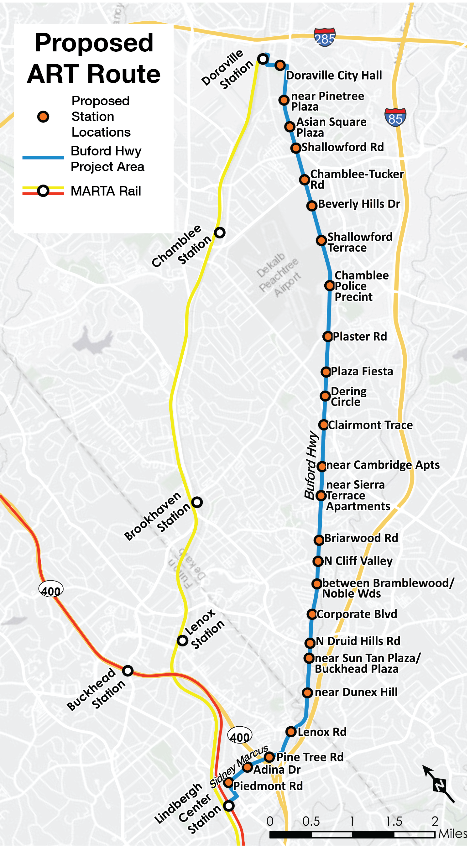
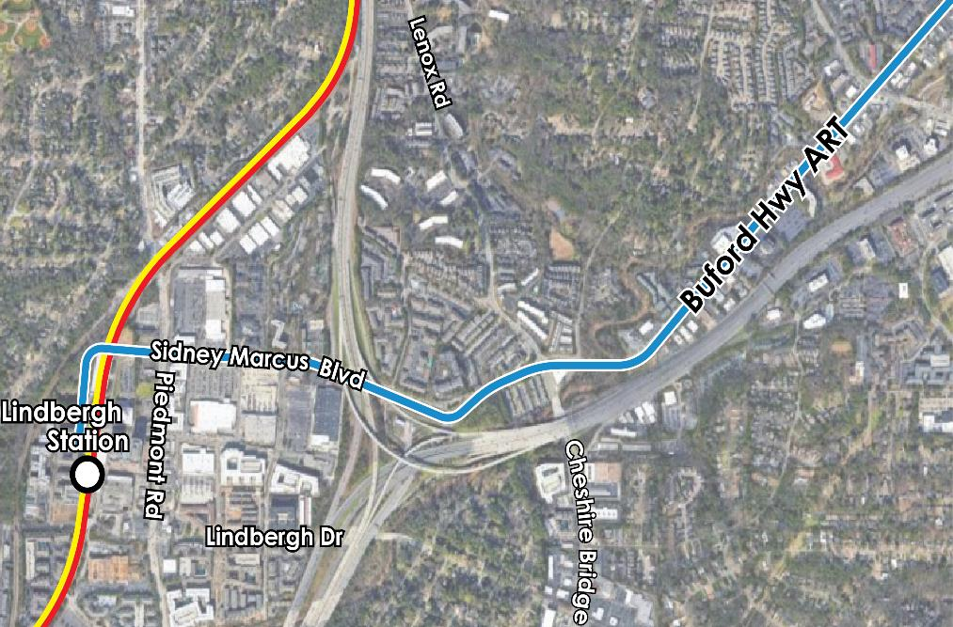
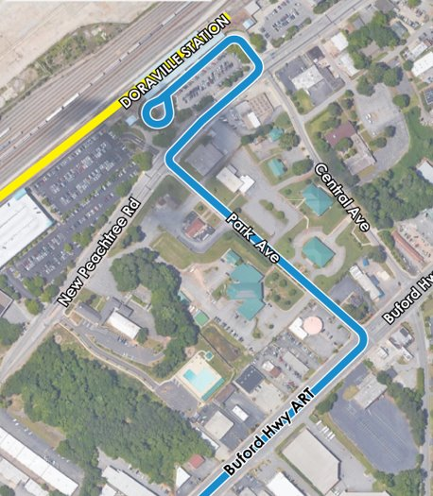
Project Boundaries
Southern Terminus
Assuming Lindbergh
Access via Sidney Marcus
Northern Terminus
Assuming Doraville
Access via Park Avenue
Notes:
This slide shows the proposed station locations based on the third mile spacing scenario. This image can also be viewed in more detail on the boards provided.
We also wanted to highlight some of the next steps in this process, which will be around how to best connect from Buford highway into the Lindbergh and Doraville Rail stations. A goal of the project is to improve the travel time on the route and improvements in these connections will be needed to ensure the most seamless connections to the rail stations. These options will be determined as MARTA continues to develop the conceptual design plans.

Slide 16
Project Timeline
2022 | 2023 | 2024
Project Development
Conceptual Design
Final Design
Construction
Testing Revenue Service
Project Completion
Notes:
The proposed project is intended to be completed by the end of 2024. Over the next six month, we will complete the conceptual design phase and move into the final design phase, which will take approximately 12 months and then construction will begin.

Slide 17
Discussion
Contact us:
Tracie Roberson Transit System Project Planner MARTA Office of Transit System Planning 2424 Piedmont Rd NE Atlanta, GA 30324-3330 bufordhwyart@itsmarta.com
Notes:
Thank you for your time this evening and we look forward to your questions and discussing about this exciting project.

Slide 19
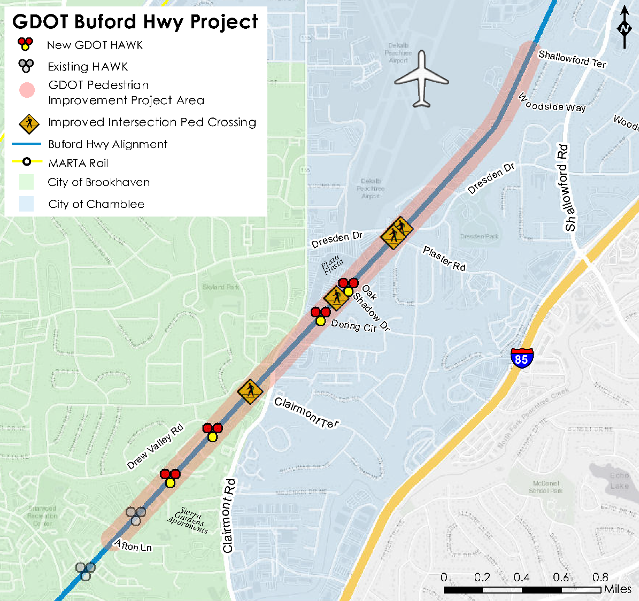
Coordination with GDOT
Pedestrian Improvements
Afton Lane to Shallowford Terrace
Sidewalks
Medians
HAWK signals and crossings
Utility improvements
Q1 2022 project letting
GDOT coordination ongoing
Signal Optimization
Coordination on Transit Signal Priority

